Slide 1



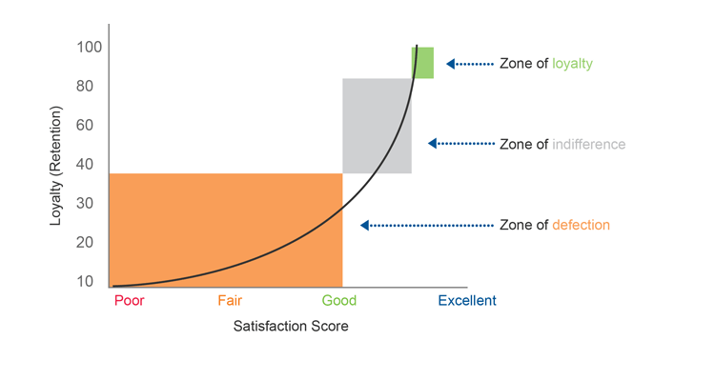
Blogs – Links:
https://blog.dataiku.com/churn-analytics-marketing-team-best-friend
https://towardsdatascience.com/how-to-leverage-ai-to-predict-and-prevent-customer-churn-f84d653a76fb
https://towardsdatascience.com/hands-on-predict-customer-churn-5c2a42806266
https://towardsdatascience.com/churn-prediction-770d6cb582a5
https://www.kdnuggets.com/2019/05/churn-prediction-machine-learning.html
https://www.bizdata.com.au/blogpost.php?p=customer-churn-prediction-with-algorithms
https://www.zylotech.com/blog/how-to-predict-and-prevent-your-customer-churn
References:
Luo, B. , Shao, P., Liu, J.: Customer Churn Prediction Based on the Decision Tree
in Personal Handyphone System Service. In: International Conference on Service
Systems and Service Management, pp. 1—5 (2007)
B. BaesensAnalytics in a Big Data World: The Essential Guide to Data Science and its Applications
John Wiley & Sons (2014)
K. Coussement, K.W. De BockCustomer churn prediction in the online gambling industry: the beneficial effect of ensemble learning
J. Bus. Res., 66 (9) (2013), pp. 1629-1636
W. Verbeke, D. Martens, C. Mues, B. BaesensBuilding comprehensible customer churn prediction models with advanced rule induction techniques
Expert Syst. Appl., 38 (3) (2011), pp. 2354-2364
N.J. Radcliffe, R. SimpsonIdentifying who can be saved and who will be driven away by retention activity.
J. Telecommun. Manag., 1 (2) (2008)
D. Sculley, G. Holt, D. Golovin, E. Davydov, T. Phillips, D. Ebner, V. Chaudhary, M. Young, J.-F. Crespo, D. DennisonHidden technical debt in machine llearning systems
C. Cortes, N.D. Lawrence, D.D. Lee, M. Sugiyama, R. Garnett (Eds.), Advances in Neural Information Processing Systems 28, Curran Associates, Inc. (2015), pp. 2503-2511
Predict and Prevent Customer Churn using Data Science
Introduction
Purpose of the project is to study customer’s behavior and data to predict and possibly prevent customer churn using data science techniques. Customer churn occurs when customers or subscribers stop doing business with a company or service. Also known as customer attrition or turnover, it is a critical metric due to the cost savings for a company to retain a customer in comparison to acquiring new ones. Awareness about cutomer churn helps an organization define customer retention processes, project goal success rates and identify strategies for improvement.
Why is this topic Data Science?
Taking a large sample of clients who have transitioned to other companies, and reviewing what commonalities the clients share to help identify key factors that allow a company to target at-risk individuals. With the ability to apply Machine Learning algorithms to the client base, this allows the system to identify any shared traits across the client base that have “churned”. Once these traits are identified the current client base will be compared using a decision tree method to help identify the at-risk individuals. Through a mixture of customer traits and customer surveys the company will be able to identify what clients are most dissatisfied with and what they value most within the company. Identifying these individuals early will allow the company to customize their marketing campaigns to a set of shared traits and demographics.
Blogs – Links:
https://blog.dataiku.com/churn-analytics-marketing-team-best-friend
https://towardsdatascience.com/how-to-leverage-ai-to-predict-and-prevent-customer-churn-f84d653a76fb
https://towardsdatascience.com/hands-on-predict-customer-churn-5c2a42806266
https://towardsdatascience.com/churn-prediction-770d6cb582a5
https://www.kdnuggets.com/2019/05/churn-prediction-machine-learning.html
https://www.bizdata.com.au/blogpost.php?p=customer-churn-prediction-with-algorithms
https://www.zylotech.com/blog/how-to-predict-and-prevent-your-customer-churn
References:
Luo, B. , Shao, P., Liu, J.: Customer Churn Prediction Based on the Decision Tree
in Personal Handyphone System Service. In: International Conference on Service
Systems and Service Management, pp. 1—5 (2007)
B. BaesensAnalytics in a Big Data World: The Essential Guide to Data Science and its Applications
John Wiley & Sons (2014)
K. Coussement, K.W. De BockCustomer churn prediction in the online gambling industry: the beneficial effect of ensemble learning
J. Bus. Res., 66 (9) (2013), pp. 1629-1636
W. Verbeke, D. Martens, C. Mues, B. BaesensBuilding comprehensible customer churn prediction models with advanced rule induction techniques
Expert Syst. Appl., 38 (3) (2011), pp. 2354-2364
N.J. Radcliffe, R. SimpsonIdentifying who can be saved and who will be driven away by retention activity.
J. Telecommun. Manag., 1 (2) (2008)
D. Sculley, G. Holt, D. Golovin, E. Davydov, T. Phillips, D. Ebner, V. Chaudhary, M. Young, J.-F. Crespo, D. DennisonHidden technical debt in machine llearning systems
C. Cortes, N.D. Lawrence, D.D. Lee, M. Sugiyama, R. Garnett (Eds.), Advances in Neural Information Processing Systems 28, Curran Associates, Inc. (2015), pp. 2503-2511
Acknowledgements
What is the deliverable for this project?
The client is able to be attain an actionable list of clients that are at-risk in tandem with survey results that provide key items that clients want from their company. By applying targeted marketing campaigns and promotions that align with the clients needs and are targeted to the most at-risk clients, the company will be able to proactively engage the clients and work with them to keep them as valued clients. The clients received tailored marketing which provides them the key features they are seeking, and the client is able to reduce overhead costs by keeping existing customers.
Conclusion:
Through the use of data science techniques a company is able to identify commonalities between customers that have churned, apply those identified traits to the current customer base and using a weighting system, they can created targeted marketing campaigns for those at-risk customers. Using survey results, the company will be able to quickly identify what products or services the clients deem valuable and provide promotions customized for those services. The clients are able to receive products that more closely fit their needs and the company is able to keep a more status customer base, and increase their return on investment.

